Slide 1
The Identity of Jesus

Slide 2
In this unit you will cover…
The titles of Jesus (Son of God, Christ, Messiah, Son of Man, Son of David and Saviour).
STORIES
The Ministry of John the Baptist.
Peter’s declaration about Jesus.
The Transfiguration.
Jesus’ entry into Jerusalem.
The calming of the storm.
The request of James and John.
Blind Bartimaeus.

Slide 3
Titles of Jesus
Title | Meaning
Son of God | Never used by Jesus. Used by Mark at Jesus’ baptism & transfiguration. In Jewish Scripture the King of Israel was sometimes called God’s son.
Christ | Greek – anointed one. Used for people with a special task in Jewish Scripture. High priests and kings were anointed with oil as a sign that God chose them.
Messiah | Hebrew – anointed one. The Jews believed a Messiah would save them from the Romans and restore the glorious reign of King David. Never used by Jesus, used by Peter in his declaration.
Son of David | Most Jews expected the future Messiah to be a descendant of King David (the greatest king of Israel). Jesus’ family tree can be traced back to David. Used by Blind Bartimaeus and at Entry into Jerusalem.
Son of Man | Used often by Jesus meaning ‘a heavenly being with power and authority from God’. Comes from prophecies (Ezekiel and Daniel).
Saviour | Jesus means ‘God saves’. Jesus offers salvation to humans through his death and Resurrection. He sacrificed himself and took mans punishment.

Slide 4
Titles and their meaning for Christians today
Son of God
Shows that God is a Trinity (Father, Son and Holy Spirit); Jesus has always existed.
Validity of the Resurrection- death is not the end of life; Jesus is alive and still active in the world today.
Highlights the power of Jesus- Son of God helped followers at the time of Jesus; Son of God has the power to help Christians today. Jesus’ character reflects his power and divinity. Examples of miracles portray Jesus as Son of God e.g. healing of the man with the paralysed hand.
It shows that Jesus shares God’s powers.
It shows the unique relationship that Jesus has with God.
It has no political ties or implications.
It is easily understood as it is self-explanatory.

Slide 5
Son of Man
Christ / Messiah
Jesus is a supernatural being.
Jesus is approved by God.
Jesus has the authority of God.
Jesus still forgives sins.
Connection between OT and NT (proves JC is fulfilment of OT prophecy).
Therefore JC is the anointed/chosen one…so sin is forgiven.
God is faithful to his promises- Christians today can rely upon and trust God.

Slide 7
1 “This is the Good News about Jesus Christ, the Son of God”
What does Mark 1:1 tell us?
Name three things.
Mark is expert at being subtle, and condensing important information. Little phrases, even his choice of particular words, can be saying a lot..

Slide 8
Unit 2 - The Identity of Jesus The Ministry of John the Baptist
Learning Intentions:
I can make comparisons between John the Baptist and Elijah (Old Testament prophet);
I can retell the story of Jesus’ baptism;

Slide 9
This is a prophecy from the OT. Mark shows John the Baptist is “preparing the way” for Jesus - as the OT predicts – for Mark, Jesus is the fulfilment of scripture…
This is the Good News about Jesus Christ, the Son of God. It began as the prophet Isaiah had written: God said, I will send my messenger ahead of you to open the way for you. Someone is shouting in the desert, “Get the road ready for the Lord; make a straight path for him to travel!”
So John appeared in the desert, baptizing and preaching. “Turn away from your sins and be baptized,” he told the people, “and God will forgive your sins.” Many people from the province of Judea and the city of Jerusalem went out to hear John. They confessed their sins, and he baptized them in the Jordan River.
John wore clothes made of camel's hair, with a leather belt around his waist, and his food was locusts and wild honey. He announced to the people, “The man who will come after me is much greater than I am. I am not good enough even to bend down and untie his sandals. I baptize you with water, but he will baptize you with the Holy Spirit.”
John is not in the Jewish temple.. he is outside of it, in the wilderness- God is doing something new in Jesus, something beyond the Jewish religion ....
Mark is not writing a biography, or history – he is writing the gospel to express his understanding of who Jesus is – he is writing FROM FAITH…
With PEE, give two beliefs about Jesus to show Mark is writing from faith Mark is writing from faith, because in Ch.1 he expresses the belief that… this is shown by the quote… which means…
This coming Messiah will not just be the awaited Jewish King – He will be God himself – only God can pour out God’s spirit…

Slide 10
John the Baptist and Elijah
Mark believed that John was just like the prophet Elijah.
Read pages 20-21 of your textbook and explain the comparisons Mark made.
Point of comparison | Evidence
John was the second Elijah. John the Baptist is the fulfilment of the prophecy stated by Isaiah
“A voice of one calling: ‘In the wilderness prepare the way for the Lord; make straight in the desert a highway for our God.‘ “ (Isaiah 40:3)
“I tell you, however, that Elijah has already come and the people treated him just as they pleased, as the Scriptures say about him.” (Mark 9: 12-13)
John the Baptist dressed almost exactly like Elijah
“He was wearing a cloak made of animal skin, tied with a leather belt’, they answered. ‘It’s Elijah!’ the king exclaimed.” (2 Kings 1:8)
“John wore clothes made of camel’s hair, with a belt around his waist, and his food was locusts and wild honey.” (Mark 1:6)

Slide 11
The Story of Jesus’ Baptism

Slide 12
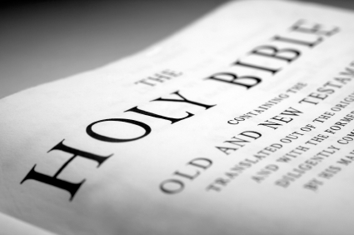
It began as the prophet Isaiah had written….
God said: ‘I will send my messenger ahead of you to open the way for you. Someone is shouting in the desert, ‘Get the road ready for the Lord; make straight a path for him to travel!’

Slide 13
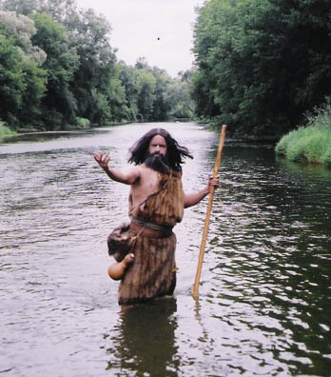
So John appeared in the desert….
…baptising and preaching

Slide 14
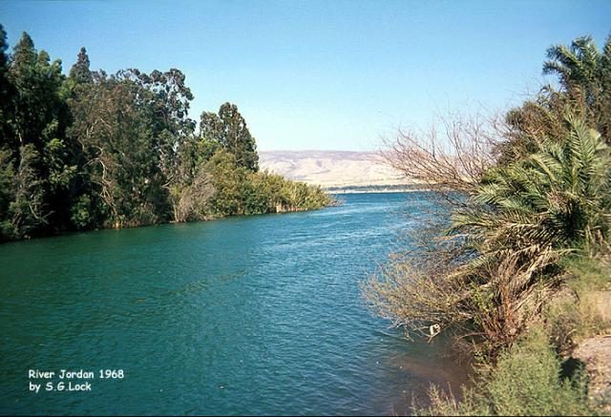
Jesus was baptised by John in the River Jordan

Slide 15
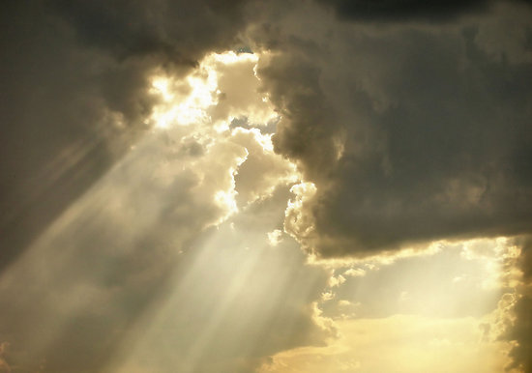
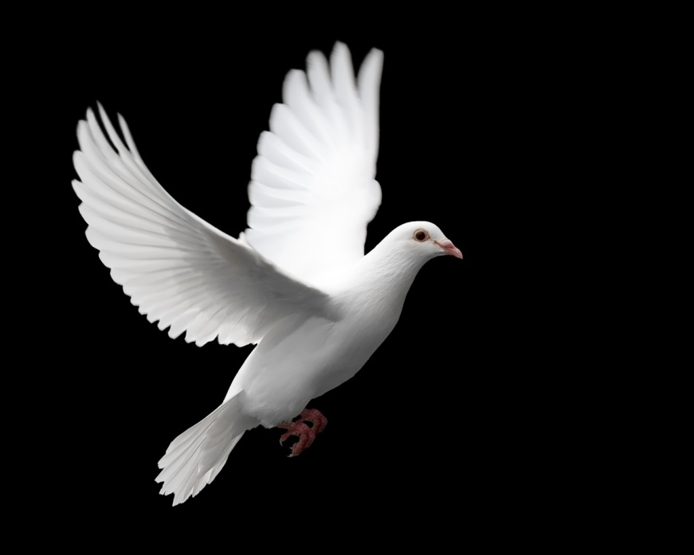
As Jesus was coming up from the water he saw the heaven being torn open and the Spirit descending on him like a dove.

Slide 16
And a voice came from heaven: ‘You are my Son, I am pleased with you.’

Slide 17
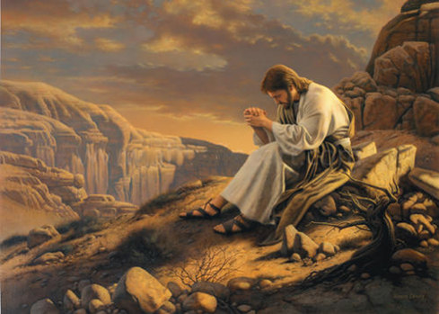
At once the Spirit made him go into the desert, where he stayed for forty days, being tempted by Satan.

Slide 18
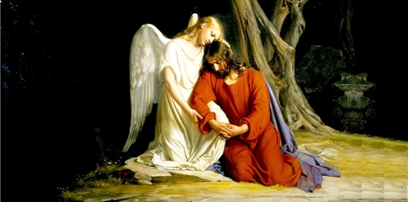
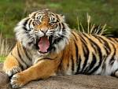
Wild animals were there also, but angels came and helped him.

Slide 19
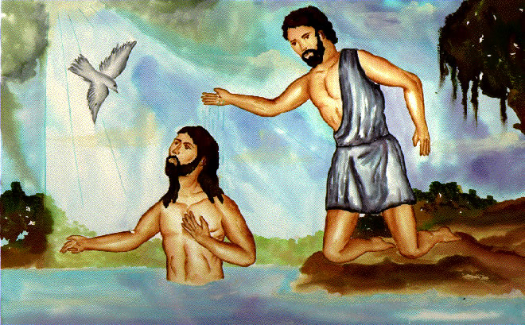
https://www.youtube.com/watch?v=cam5_bvAaEM
Create your own story board detailing the story of Jesus’ Baptism. Discuss with your partner which key points you need to include.

Slide 20
Plenary
Describe John the Baptist in five key points.
Who he was;
How he dressed and what he ate;
His purpose;
Who he was compared to;
His relationship to Jesus.
Summarise Jesus’ Baptism in three sentences.

Slide 21
The Importance of Jesus’ Baptism - Part 1
Learning Intentions:
I can explain the symbolism of Jesus’ baptism;
I can explain how events at Jesus’ baptism show Christians who Jesus is;
I can explain how events at Jesus’ baptism show Christians what is going to happen.

Slide 22
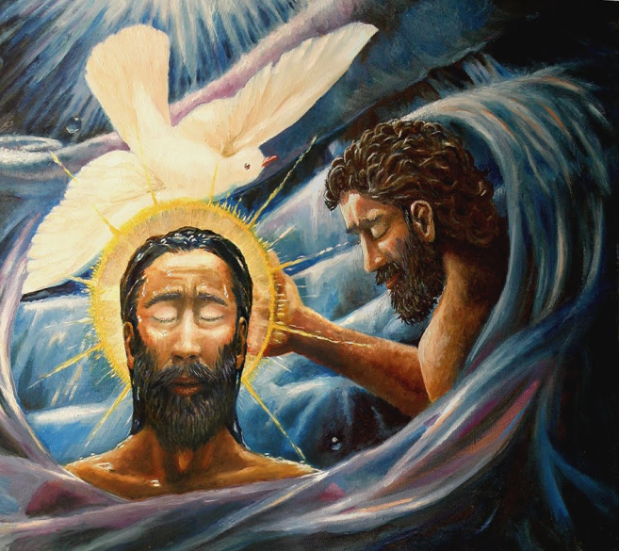
Jesus’ Baptism
Underline/highlight the parts that you think could be hinting at something important.
Using your table, explain two ways in which Jesus’ baptism shows us who Jesus is.
Using your table, explain one way in which Jesus’ baptism shows us what is going to happen.
Not long afterward Jesus came from Nazareth in the province of Galilee, and was baptized by John in the Jordan.
As soon as Jesus came up out of the water, he saw heaven opening and the Spirit coming down on him like a dove.
And a voice came from heaven, “You are my own dear Son. I am pleased with you.”
Not long afterward Jesus came from Nazareth in the province of Galilee, and was baptized by John in the Jordan.
As soon as Jesus came up out of the water, he saw heaven opening and the Spirit coming down on him like a dove.
And a voice came from heaven, “You are my own dear Son. I am pleased with you.”
“You are my own dear Son. I am pleased with you.”

Slide 23
Meaning of events at Jesus’ baptism
Jesus’ baptism shows who Jesus is…
Holy Spirit like a dove anointing Jesus shows Jesus really is the Messiah, the Anointed one, the Christ
God tells Jesus “you are my son”. Jesus really is divine – he has not become so.
Jesus will be a suffering servant. Echoes of Isaiah’s description of the suffering Servant “with you I am well pleased”.
Jesus’ baptism shows what is going to happen…
God’s rule is coming: The heavens “opening” shows God’s presence and kingdom appearing.
God is engaged in a new act of creation - Spirit coming down on him like a dove, transforming the world.
God’s rule is neither violent nor hurtful: Jesus will act in the gentleness and peace of a dove.

Slide 24
Which three themes does Jesus’ baptism show?
Who is Jesus
The way of the Cross
Hope and encouragement
Discipleship
Salvation for all
Jesus’ baptism shows us who Jesus is:
He is shown to be the Messiah because…
He is shown to be fully God because…
Jesus’ baptism encourages Christians to believe in Jesus as the Son of God because…
Jesus’ baptism shows the theme of the Way of the Cross, because…
1. “Who is Jesus?”
Messiah
Fully God and fully man
2. “Hope and Encouragement”
Proves that you can believe Jesus is Son of God
3. “Way of the Cross”
that Jesus will be a suffering Messiah.

Slide 25
Plenary Activity: Tell your partner about what things in Jesus’ baptism mean..
?heavens opening
?voice
?dove
?”well pleased”
?”my Son”

Slide 26
Explain what each part of Jesus baptism means
?voice
Shows Jesus is the Messiah, God’s anointed one.
Jesus comes in peace.
Is also like a new act of creation (Gen 1:1)
God’s truth, Kingdom and rule are coming.
?heavens opening
God is totally other, neither male nor female. A voice from heaven represents God
?dove
? “my Son”
? “well pleased”
Shows God’s approval. Also hints Jesus will be like the suffering servant.
Jesus is, and always was, God’s son – divine, like God.

Slide 27
The Importance of Jesus’ Baptism – Part 2
Learning Intentions:
- I understand the significance of Jesus’ baptism for Jesus, and its importance for Christians today.
- To reflect on the effects of Jesus’ baptism on Jesus
In Mark, Jesus’ baptism is a private experience: no-one except Jesus hears the voice or sees the Spirit.
What effect would this event have on Jesus ?

Slide 28
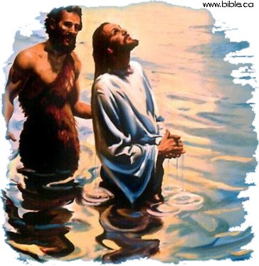
Meaning for Jesus
Explain three ways that Jesus’ baptism is important for him.
Which of these ways do you think was most significant for Jesus himself?
How is Jesus’ baptism a “watershed” moment, marking a new phase in his life?
Confirms him as the Messiah, the Christ (=the anointed one)
Confirms that he is the Son of God: in a unique relationship with God – and therefore has a unique authority
Confirm that he has a mission to fulfil (in the OT the Spirit is given to people for carrying out a special task) - to proclaim God’s rule, with his authority as Son of God.

Slide 29
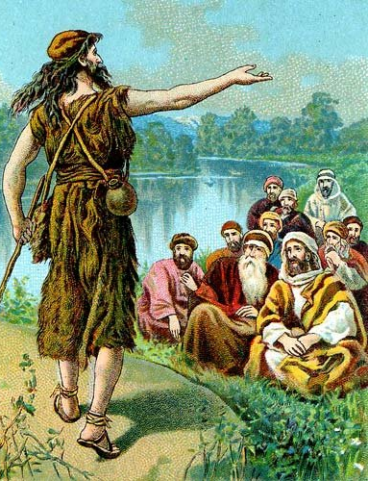
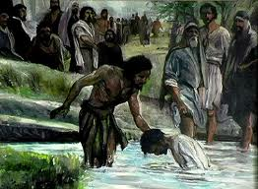
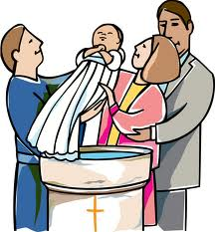
Why did Jesus, who was sinless, go to be baptised by John, for the forgiveness of sins?

Slide 30
On the next slide…
Identify the eight correct answers why Jesus chose to be baptised, even though he was sinless.
Find two reasons why Christians get baptised.

Slide 31
To purify himself of any sins before starting his mission
To mark a turning-point in his life – it marked the beginning of his ministry
To start a new mission of proclaiming God’s kingdom
To identify himself with sinful humanity, and take our sins as his own: since it is our sins he will die for
To be part of a new, purified, committed “people of God”
To show he is humble: and be an example to us of humility
To show he was the one for whom John was preparing the way
To show that John is his master, and he is John’s disciple
To show his approval of baptism
To use this opportunity to declare himself as the Messiah to the public
There was Jewish belief that the Messiah would be anointed by a prophet (as all Jewish prophets and kings were)
To connect with other people – showing he was the Son of Man – fully human as well as fully divine.
JESUS
JESUS
CHRISTIANS
JESUS
CHRISTIANS
JESUS
JESUS
JESUS
JESUS
JESUS

Slide 32
What is the significance of Jesus’ baptism for Christians today?
Like Jesus, Christians get baptised in water to…
embark upon a new mission
Be part of a new, dedicated people of God
Resurrection – removal of sin
Homework Task: Research the three points above and explain how each one links to baptism for Christians today.

Slide 33
Starter Activity
https://www.youtube.com/watch?v=gITf-xoWgfc
How does the clip link to baptism?
Why is baptism an ‘initiation’ into the Christian Church?

Slide 34
Baptism and Christianity today
Learning Intentions:
I can critically assess whether or not baptism is necessary for Christians today.
I have reflected upon and can evaluate adult baptism vs infant baptism

Slide 35
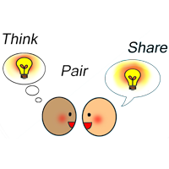
Do you think it is necessary for Christians to be baptised?
Think / Pair / Share
Post-it note activity
Green post-it note = Yes it is necessary
Orange post-it note = No it is not necessary

Slide 36
2. God showed he approved of baptism
3. Adult baptism shows a turning-point in your life
4. It is traditional
1. Jesus was baptised – we should follow his example
Yes
5. Jesus commanded his disciples to baptise believers
Is it necessary for Christians to be baptised?
1. Infant baptism doesn’t mark a turning point in your life
No
4. It has lost much of its meaning today
2. Not all Churches baptise – the Salvation Army doesn’t baptise
3. A personal relationship with God is the most important thing, not baptism

Slide 37
Bapt ism
Today Christians want to follow Jesus’ example and be baptised.
Although different Christians denominations have different ideas how this should be done, it is very important to them all.
Infant Baptism is where a baby is baptised shortly after it is born. Parents choose to have their babies baptised as a way of welcoming the child into the Christian faith and Church.
Confirmation is when a child (usually around 10-13) who has been baptised as a baby wants to confirm they want to be a part of the Christian faith.
Believer’s Baptism or Adult Baptism is a way of a person showing that they have made their own decision to follow the Christian faith and become part of the Church once they are old enough to make a choice like that for themselves.

Slide 38
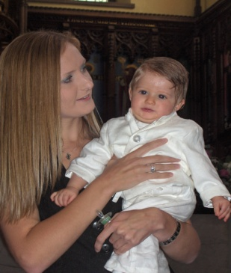
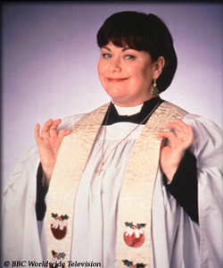
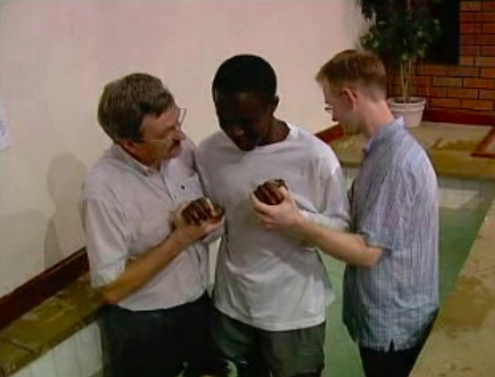
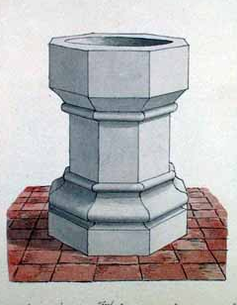
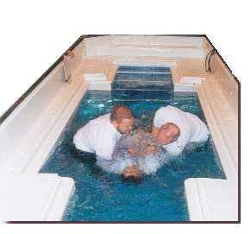
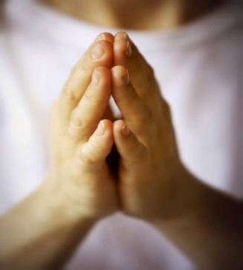
Infant Baptism
Believer’s Baptism
Family bring the baby to be baptised
The person tells the church why they want to be baptised
The vicar/minister/priest
asks the family if they accept the Christian faith and promise to bring up the child as a Christian
The vicar/minister/priest asks the person if they have accepted the Christian faith and promise to live a Christian life
The person is lowered in to the water and completely covered in water. This represents being cleaned and starting a new life
The baby has water poured over its head three times representing being cleaned from sin.
Godparents and the Church promise to help the child grow in their Christian faith
The vicar/minister/priest and the Church pray for God to help the person to grow in their Christian faith.

Slide 39
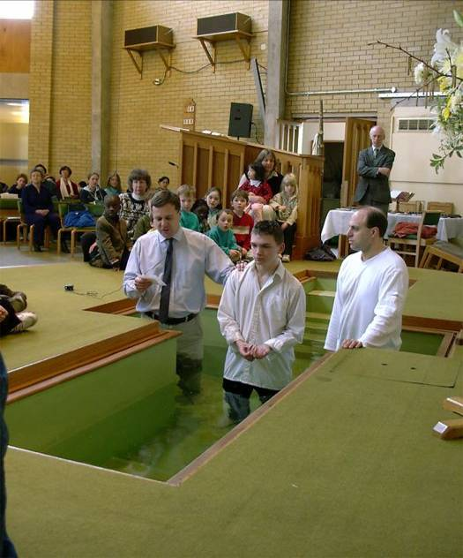
What do you notice about the shape of this baptistery?
Why do you think it is shaped like this? Give reasons.

Slide 40
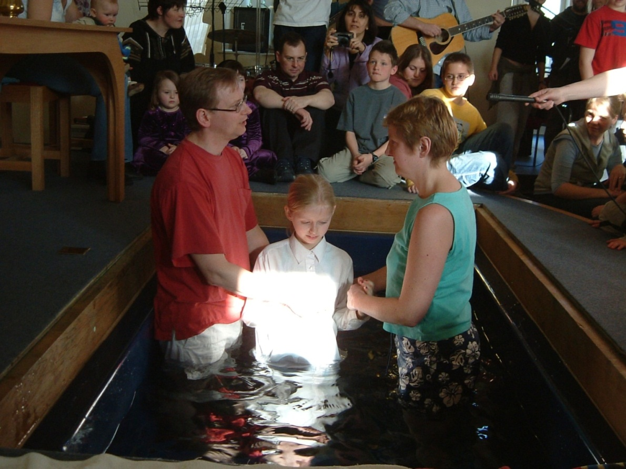
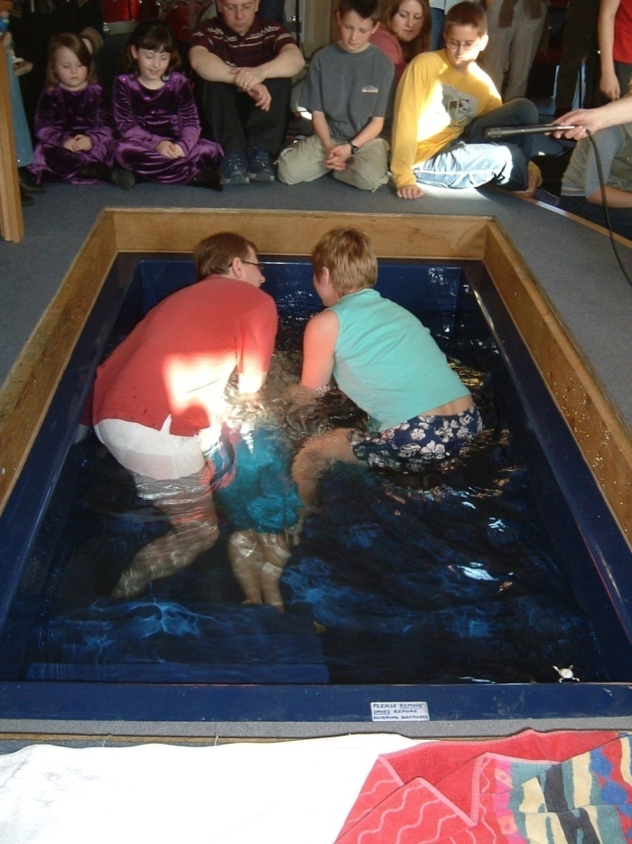
Watch the following clip showing four believers’ baptism and answer the following questions:-
What did you notice about the robe that the first lady put on?
What does it symbolise?
What happened to the people who were being baptised?
What do you think the purpose of this is?
The people being baptised go down one set of steps but up another. – what do you think this could symbolise?
Notes:
Believer’s Baptism clip

Slide 41
Infant Baptism V Adult Baptism
Why do parents decide to get their children baptised as babies?
Why do people wait until they are older before they are baptised?
Families can celebrate the birth of a new baby and welcome him/her into the family of the Church.
It is a commitment for the parents to bring the child up in the Church- parents want to make promises on the child’s behalf.
It means the child will have the support and prayers of the congregation as it grows up.
Parents want to ask for God’s help and the help of the Church in bringing up the child wisely.
Parents want Original Sin removed as soon as possible.
Some people believe that the child will go to heaven if they are baptised.
It is the tradition of most churches to baptise infants.
This gives people a chance to make the promises for themselves- Just like Jesus chose.
The person being baptised fully understands what it means and makes the choice themselves because they are an adult and so would make a stronger commitment to God.
That baptism should be done the same way as it was when John baptised Jesus- following Jesus’ example.
Jesus’ baptism marked a turning-point in his life. Baptism today should also be a choice to change your life.
People get the chance to explain what Jesus means to them by giving a personal testimony.
Parents can still make promises about bringing the child up as a Christian- without the need for baptism.
It is more memorable and significant as an adult because they will remember it.

Slide 42
Do you think that people should choose to be baptised? (10marks)
I agree that people should choose for themselves whether or not to be baptised. Jesus chose to be baptised, so a person should also make the choice themselves (1).
Jesus’ baptism marked a turning-point in his life. Baptism today should also be a choice to change your life (1).
Jesus was baptised as an adult – this gives support for adult rather than infant baptism (1).
You would understand your decision more because you are an adult and so you would make a stronger commitment to God (1).
It is more memorable and significant as an adult because you will remember it (1).
However, other people might disagree with the statement. It is the tradition of most churches to baptise infants and so this should be continued (1).
It means that a child will be welcomed in to the family of God (1).
It means the child will have the support and prayers of the congregation as it grows up (1).
It is a commitment for your parents to bring you up in the Church (1).
Some people believe that the child will go to heaven if they are baptised (1)

Slide 43
Past Paper Question
‘Through his baptism Jesus showed true humility. Christians should follow his example.’ How do you think Christians could do this in their everyday lives?
Humility: not to be boastful, to put the needs of others before yourself

Slide 44
For your folder task – pg22
Reference | Who calls Jesus ‘God’s Son’?
1:1
1:11
3:11
5:5-7
9:7
13:32
14:61
15:39
Mark: ‘This is the good news about Jesus Christ, the Son of God’
God, at Jesus’ baptism: ‘You are my own dear Son. I am pleased with you.’
Evil spirits: ‘You are the Son of God!’
An evil spirit possessing a man living in the tombs: ‘Jesus, Son of the Most High God! What do you want with me?’
God, at the Transfiguration: ‘This is my own dear Son – listen to him!’
Jesus, when teaching: ‘No one knows, however, when that hour or hour will come – neither the angels in heaven or the Son.’
Jesus, at his trial before the High Priest. He is asked if he is the Messiah, the Son of the Blessed God. To this, Jesus replies, ‘I am’.
The army officer standing at the cross when Jesus dies: ‘This man really was the Son of God.’

Slide 45
Peter’s Declaration about Jesus
Learning Intentions:
I can explain the meaning of ‘Christ/Messiah’;
I can give an account of Peter’s declaration about Jesus;
I understand and can explain the conversation that followed between Peter and Jesus.

Slide 46
Task 1
Turn to page 8 of your Set Text booklet;
Read Peter’s declaration about Jesus and answer the seven questions that follow.
8 minutes
Task 2
Turn to page 22 of your Textbook;
Read through the analysis of Peter’s declaration and answer the four ‘For your folder’ questions in full sentences.
12 minutes
Task 3
Pair discussion question:
Why is it important for Christians that Jesus was identified as the Messiah, and not just a good man?
5 minutes

Slide 47
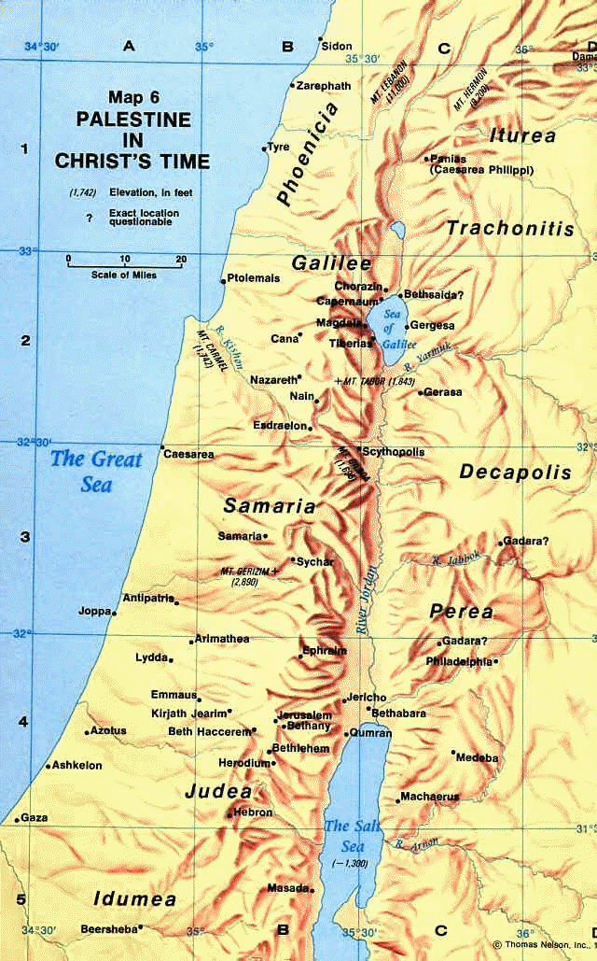
Peter’s Declaration
Caesarea Philippi

Slide 48
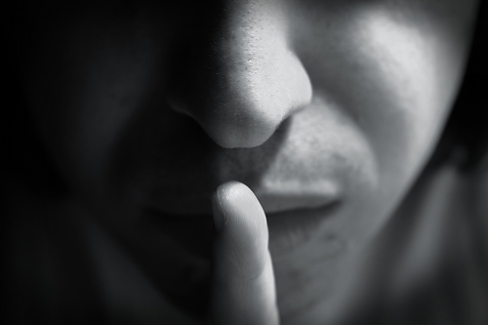
John the Baptist, Elijah or one of the prophets
Who do you say I am?
Who do people say I am?
You are the Messiah!

Slide 49
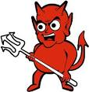
“The Son of Man must suffer and die”
MAN

Slide 50
P22 IN TEXTBOOK
Jesus told his disciples not to tell anyone what had happened. This is an example of the M_________ S__________.
Jesus then spoke to his disciples for the first time of his forthcoming _________, _________ and Resurrection.
Peter had the wrong idea of a Messiah. Like many Jews he probably thought that the Messiah would be like ___________________________________________
This event marks a turning-point in the story - ______________________________________________________________________________________

Slide 51
Peter’s declaration about Jesus
Who? Jesus and his disciples, particularly Peter!
What? Jesus asked “who do people say that I am? The disciples replied “some say John the Baptist, others say that you are Elijah, while others say you are one of the prophets.
He then asked Peter “What about you? Who do you say I am?” Peter replied “You are the Messiah.”
Jesus ordered them “Do not tell anyone about me. The Son of Man must suffer much and be rejected by the elders, the chief priests and the teachers of the Law. He will be put to death, but three days later he will rise to life.”
Peter rebuked Jesus for saying this but Jesus rebuked Peter saying “Get away from me Satan, your thoughts don’t come from God but fro human nature!”
Where? Near Caesarea Philippi

Slide 52
Peter’s Declaration - Key points
This story shows that the general public were unsure of who Jesus was.
It also shows that Peter is clear about who Jesus is (the Messiah). He was one of the first disciples to truly understand who Jesus was.
Messianic secret is shown – tell no one.
Jesus speaks of his death & Resurrection for the first time.
Jesus refers to himself as the Son of Man and is the only person in Mark’s gospel to use this term.
Peter like most Jews probably thought the Messiah would be a victorious king, saving Israel from the Romans not dying a humiliating death.
Jesus is angry at Peter for trying to stand in the way of God’s plans.
Turning point in the Gospel – start to look at last events of Jesus’ life after this!

Slide 53
Past Paper Question (2010)
Describe what happened when Jesus asked the question “Who do people say I am?” (5marks)
What would you need to include to gain full marks?

Slide 54
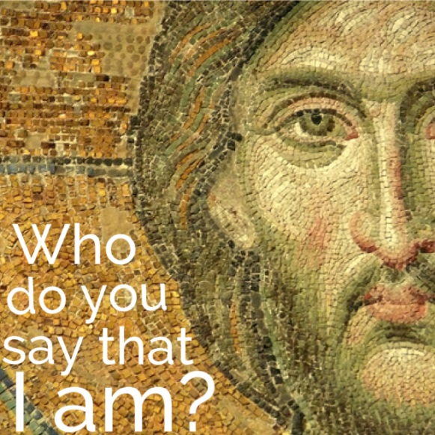
Explain why Jesus may have wanted to keep his identity a secret. (5 marks)

Slide 55
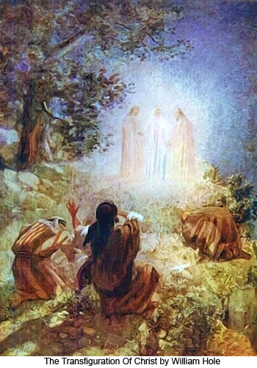
The Transfiguration
Learning Intentions:
I can retell the story of the ‘The Transfiguration’
I understand and can explain the significance of Moses and Elijah;
I understand and can explain what this story tells us about Jesus;
I can critically assess and evaluate whether people find it easy or difficult to relate to God today.

Slide 56
Task 1
Turn to page 10 of your Set Text booklet;
Read the Transfiguration and answer the eleven questions that follow.

Slide 57
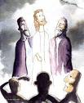
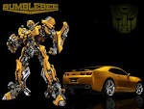
The Change in Jesus’ Appearance
‘Transfigured’ means to change appearance, making something more spiritual or important.

Slide 58
Key info: Moses
Role | God’s chosen one to free the Israelites from slavery in Egypt 10 Commandments given to Moses
Moses represents the Law

Slide 59
Key info: Elijah
Role | Challenges people to follow God Prophet for God
Elijah represents the Prophets

Slide 60
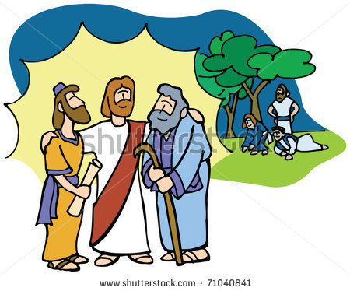
The Presence of Moses and Elijah
Jesus was shown to be equal to the two most important figures in Judaism: Moses and Elijah
Moses= the Law
Elijah= the Prophets
The Law and the Prophets are the foundation of the Jewish religion.
The appearance of Moses and Elijah with Jesus shows that Jesus fulfilled their prophecies and his teaching fulfilled their Law.
He fulfilled Judaism – he was not against it.

Slide 61
Peter offered to put up three tents for them. This was a Jewish custom to remember the great figures of Judaism. Jews still celebrate the ‘Feast of the Tabernacles’.

Slide 62
The Cloud and the Voice
In Jewish Scripture a cloud was a symbol of God’s presence - In Exodus, during the escape of the Jews from Egypt, God guided the Jews by appearing as a pillar of cloud.
The words spoken were similar to those spoken at Jesus’ baptism.

Slide 63
Added extra…
The Jews believe that Elijah will return to prepare the way for the Messiah.
Malachi 4:5-6 speaks of Elijah returning to turn the hearts of the people back to God before the Messiah appeared.
Jesus told the disciples that Elijah had already come. Who was he referring to?

Slide 64
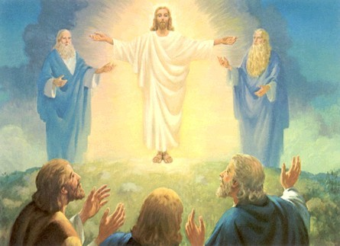
“This is my own dear Son; listen to him”
Cloud represents God’s presence
God spoke- God approved of JC and showed he was God’s Son.
Elijah Jesus Moses
Moses – figure from the Old Testament who represents Jewish Law
Elijah – figure from Old Testament who represents the Prophets
Jesus’ clothes became dazzling white- JC is more than just a man, he is the Son of God – spiritual change came over him
Both Elijah and Moses show that JC is the fulfilment of the Old Testament
Peter, James and John – Christ’s ‘Inner Circle’

Slide 65
“This is my own dear Son; listen to him”
Cloud represents God’s presence
God spoke- God approved of JC and showed he was God’s Son.
Elijah Jesus Moses
Moses – figure from the Old Testament who represents Jewish Law
Elijah – figure from Old Testament who represents the Prophets
Jesus’ clothes became dazzling white- JC is more than just a man, he is the Son of God – spiritual change came over him
Both Elijah and Moses show that JC is the fulfilment of the Old Testament
Peter, James and John – Christ’s ‘Inner Circle’

Slide 66
Past Paper Question
Describe the ways in which the disciples realise that the Transfiguration was a special event in the life of Jesus. (5 marks)
The disciples realised this was a special event as Jesus’ appearance changed – ‘his clothes became shining white.’
God’s voice spoke from heaven, commanding the disciples to listen to Jesus.
The most significant figures from the Old Testament appeared – Elijah and Moses – represent the Law and the Prophets.
Elijah’s presence showed that Jesus was the promised Messiah, as Elijah was meant to return to prepare the way for the Messiah.
Jesus told the disciples not to tell anyone about the event until he - the Son of Man - had risen from death.

Slide 67
Past Paper Question - 2013
“People today still find to easy to relate to God.”
Do you agree or disagree? Give reasons for your answer showing that you have considered different points of view.

Slide 68
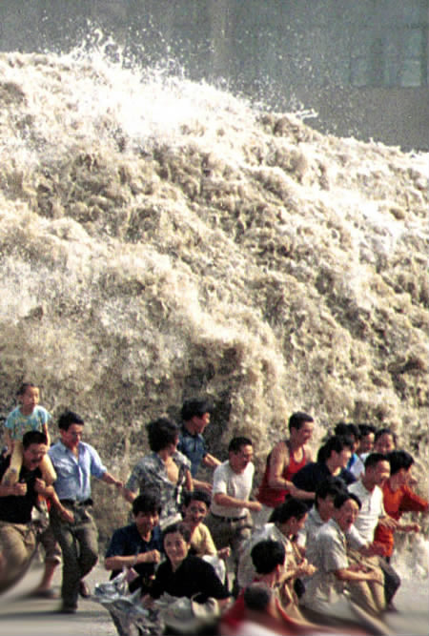
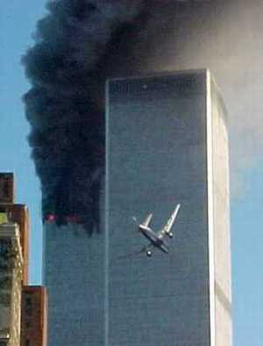
Moral and Natural Evil
Write a definition for moral
evil and natural evil.
You have 3 minutes
Notes:
Show clip – The Problem of Evil and Suffering

Slide 69
Moral or Natural evil?

Slide 70
Photographer Haunted by Horror of His Work
Kevin Carter, the South African photographer whose image of a starving Sudanese toddler stalked by a vulture won him a Pulitzer Prize, was found dead. He was 33.
The police said Mr Carter's body and several letters to friends and family were discovered. An inquest showed that he had died of carbon monoxide poisoning.
He had committed suicide.

Slide 71
“... I am haunted by the vivid memories of killings, corpses, anger and pain ... of starving or wounded children, of trigger-happy madmen…”
Kevin Carter (1960 – 1994)
His suicide note.

Slide 72
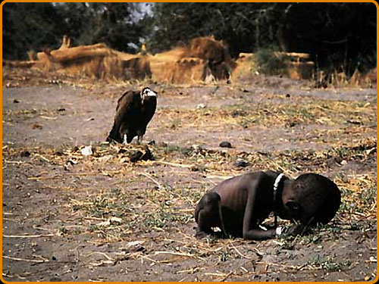
Moral or Natural evil?

Slide 73
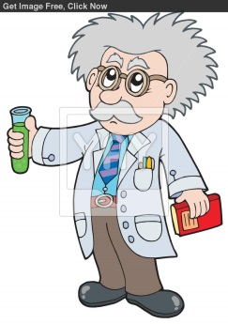
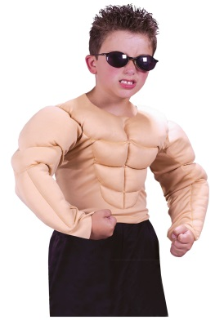
Reminder of our new vocab…
Omnibenevolent
Omniscient
Omnipotent
God is all loving
How can these words link to the existence of evil and suffering in the world?
God is all knowing
God is all powerful

Slide 74
The problem of evil
The fact that suffering exists can be a problem for believers because they want to understand:
Why would an omnibenevolent God allow suffering in a world he created?
Philosophers call this question ‘The Problem of Evil’.

Slide 75
Reasons why people find it difficult to relate to God…
The problem of evil and suffering
Sometimes people suffer due to events which are beyond human control (e.g. cancer, aids, earthquakes etc..)
If an omniscient God exists, he would know that people are suffering, because he knows everything.
If an omnibenevolent God exists, he would want to stop people from suffering, as this would be a loving thing to do.
If an omnipotent God exists, he would have the power to stop or even prevent the suffering – he could stop earthquakes, or cancer…
But people DO suffer….. Therefore people find it difficult to relate to a God that allows humans to suffer.

Slide 76
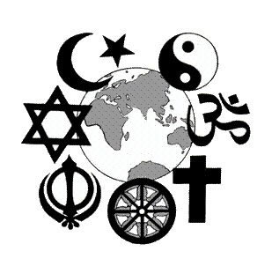
There are so many different religions which teach different things about ‘God’; they can’t all be right!
We live in a secular society; less people believe in God nowadays. This makes it more difficult to relate to God.
Why else might people find it difficult to relate to God?
There is a great deal of negative peer pressure when it comes to having a relationship with God; young people don’t want to be bullied!
Some people find it difficult to pray and when they do, God doesn’t answer their prayers; what’s the point?

Slide 77
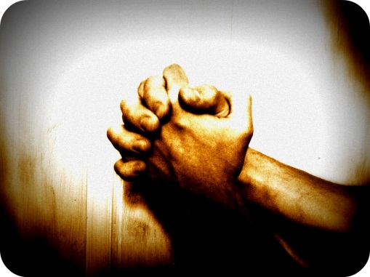
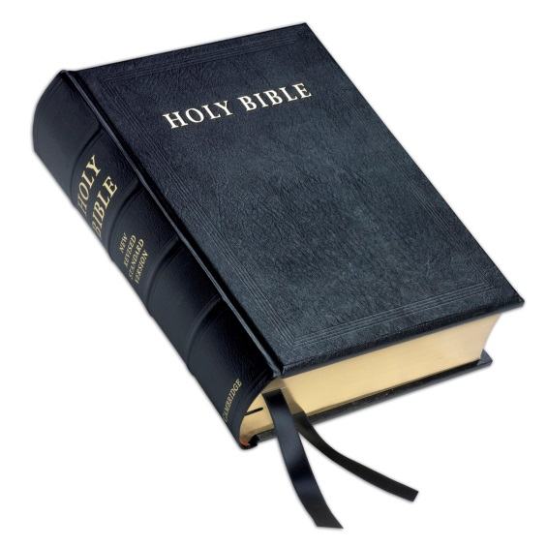
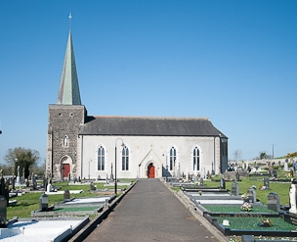
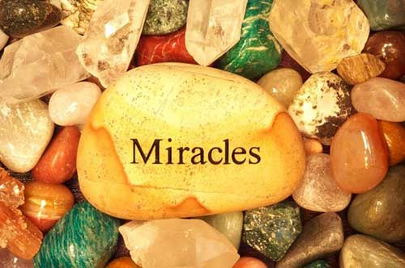
Think Pair Share Activity…
Why might people find it easy to relate to God?

Slide 78
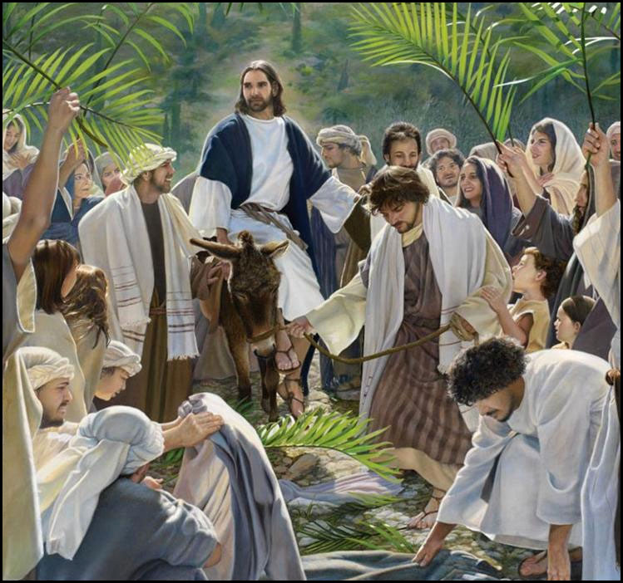
Jesus’ Entry into Jerusalem

Slide 79
Learning Intentions
I can retell the story of Jesus’ Entry into Jerusalem;
I recognise whose prophecy this fulfilled;
I can explain why Jesus rode in on a donkey and not a horse;
I can explain what this shows us about Jesus’ identity.

Slide 80
Tasks
Set Text pgs11-12
Read through Jesus’ Entry into Jerusalem and answer the eight questions that follow.
In your jotters, answer the following:
Describe Jesus’ entry into Jerusalem (5 marks)

Slide 81
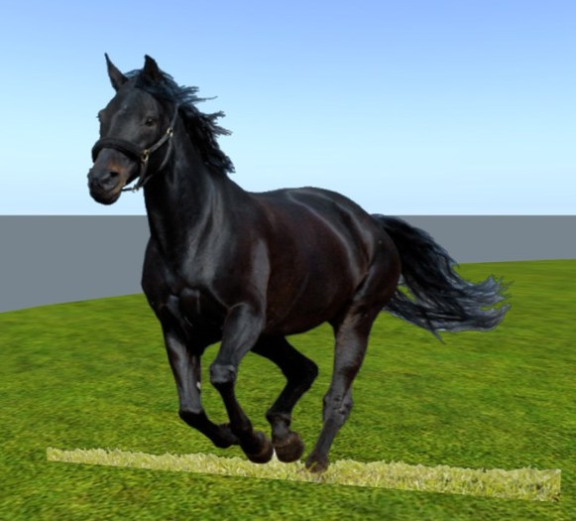
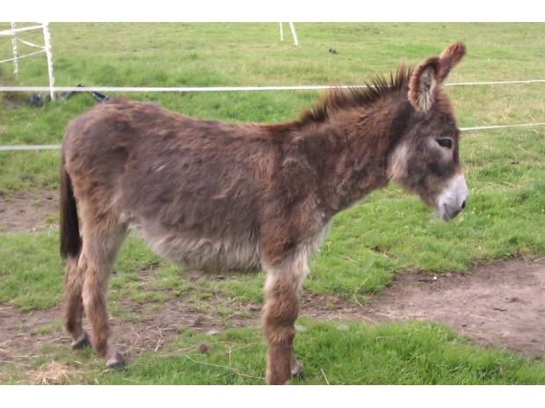
Explain why Jesus rode on a donkey and not a horse.

Slide 82
Read textbook pg25 and answer the following…
Whose prophecy did he fulfil/make come true?
What does this story show about Jesus’ identity?
How is this event remembered today by Christians?
Jesus entered Jerusalem on a donkey, symbolising peace, rather than the military power of a horse. How you do think Christians could follow Jesus’ example in their lives today? (5 marks)

Slide 83
Past Paper Questions (2015)
What animal did Jesus ride into Jerusalem? (1)
Name two things placed on the ground by the crowd. (2)
What word of praise did the crowd shout? (1)
Where did Jesus go when he entered Jerusalem? (1)
Why was this event important in the life of Jesus? (5)
“Son of David is the best title for Jesus.”
Do you agree or disagree? Give reasons. (5)

Slide 84
Why was this event important in the life of Jesus? (5)
Jesus was confirming that he was the Messiah.
Jesus fulfilled Zechariah’s prophecy.
Jesus confirmed that he was a humble servant by riding a colt.
It is important as the crowds believed Jesus to be the Messiah by placing cloaks and palm branches on the ground.
This was the first public occasion where Jesus didn’t hide his identity (messianic secret). Instead, he made a grand entrance.

Slide 85
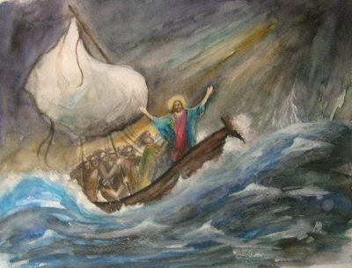
The Calming of the Storm

Slide 86
Learning Intentions
I can retell the story of ‘The Calming of the Storm’;
I understand what this story shows about Jesus’ identity;
I understand the meaning of this story for Mark’s readers;
I recognise that Christians around the world suffer persecution today;
I can explain how this story might encourage Christians who are suffering today.

Slide 87
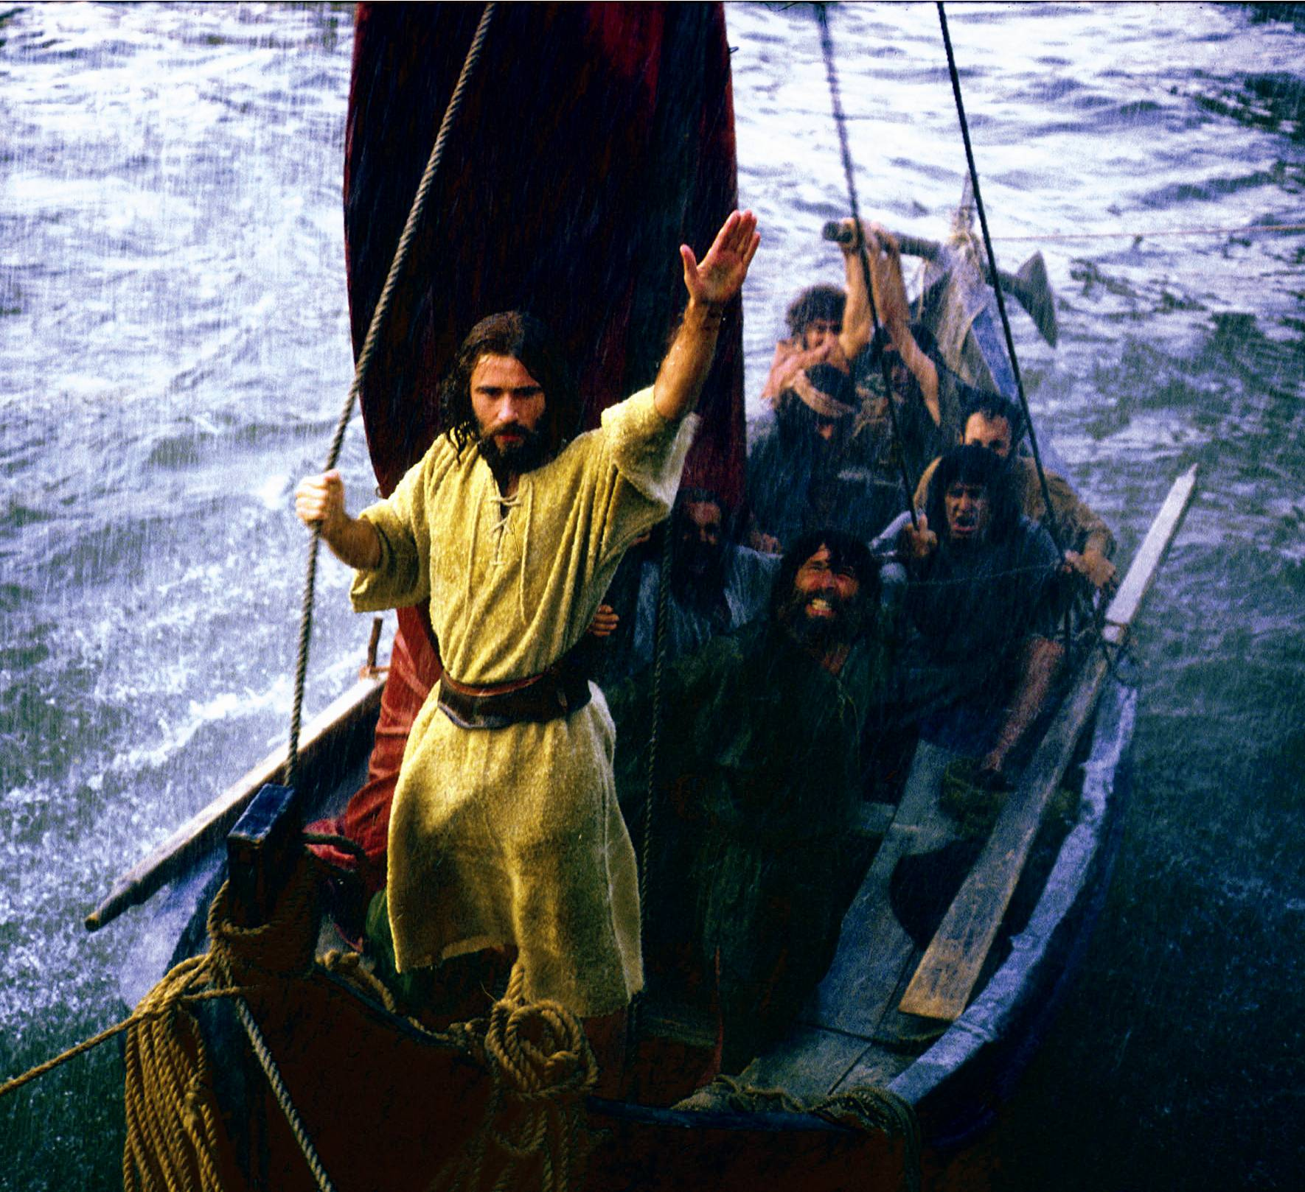
Set Text pgs. 12-13: read Mark’s account of the calming of the storm and answer the questions which follow.
In your jotters answer the following past paper question (2012):
Retell the story of Jesus calming the storm (5)

Slide 88
Calming of the Storm - Analysis
Jesus was asleep with his head on a pillow.
Sleeping peacefully is a sign of complete trust in God
This story is an example of the power Jesus had over nature. It was believed that God could control the weather.
Storms in the sea of Galilee were common but the one described must have been particularly severe- some of the disciples were experienced fishermen and they were terrified.
This miracle shows that Jesus was no ordinary man, but the Son of God
This contrasts with the lack of faith shown by the disciples. Their distress is seen in the fact they thought Jesus was sleeping because he didn’t care.
Which keyword for describing God is fitting in this story?

Slide 89
Meaning of the story

Slide 90
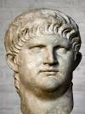
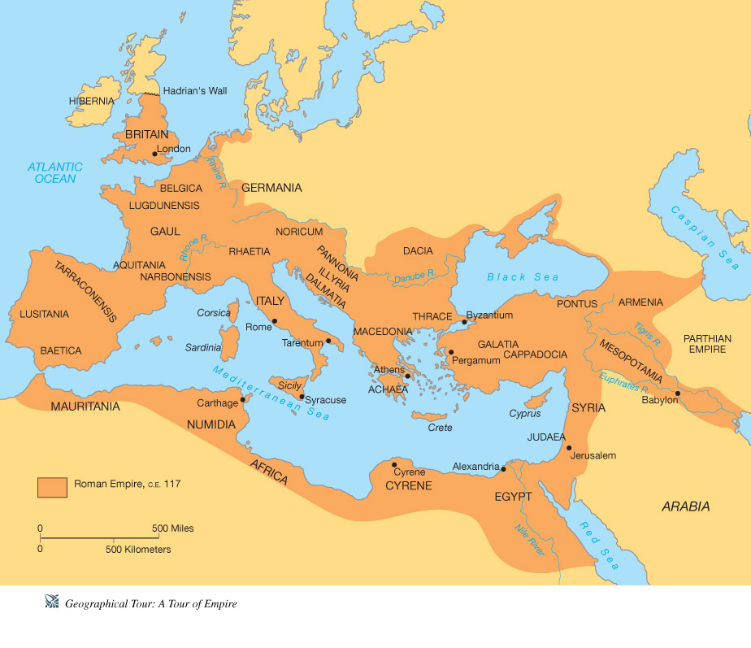
This is the Roman Emperor at this time.
What was his name?
How did he treat Christians?

Slide 91
Christians

Slide 92
How would the early Christian community find comfort from reading this account of the calming of the storm?

Slide 93
Some scholars have suggested that the story can be interpreted as an allegory
Boat = The Christian Church
Christians are assured that Christ is in control but they must have faith
The story of the calming of the storm is still important to Christians today. They believe that it gives them assurance that they can rely on God in times of trouble and uncertainty.
The Storm = The Persecution faced by the Christian Church

Slide 94
How could this event be described as a nature miracle?
What does this miracle teach about Jesus’ identity?
What does this miracle teach about faith?
Why do you think the disciples asked, ‘Who is this man?’
Explain the significance for Mark’s first readers.
Explain the significance of this story for Christians today.

Slide 95
2012 Past Paper Question: Explain the importance of the calming of the storm for Christians (5)

Slide 96
2012 Past Paper Question: ‘Son of God is the best title for Jesus.’ Do you agree? Give reasons (10)

Slide 97
Persecution

Slide 98
‘In the early 1970s, there were an estimated 3 million Christians in China. Now, the number may be as high as 130 million. However, the government continues to keep a close eye on the activities of officials churches and there has been sporadic persecution against Christians belonging to unofficial house churches.’
Christianity Today 2010

Slide 100
St Patrick

Slide 101
Martin Luther King

Slide 102
Christians still suffer ‘storms’ today…

Slide 103
Open Doors Watch List 2012
Top 10 countries for persecution of Christians
North Korea
Afghanistan
Saudi Arabia
Somalia
Iran
Maldives
Uzbekistan
Yemen
Iraq
Pakistan

Slide 105
The Request of James and John
Learning Intentions:
I can retell the story of the request of James and John;
I understand what Christians can learn about Jesus’ identity from this story;
I can explain what Christians can learn about discipleship from this story.

Slide 106
The Request of James and John
Set Texts Booklet – p13

Slide 107
Request of James and John – Summary & Analysis
Peter, James and John formed the inner circle of the disciples.
James and John asked Jesus if they could have the best seats in heaven- to sit at the right and left sides of Jesus.
They did not understand their own request as Jesus explained this would involve sharing in his suffering
James and John insisted they could endure the same ‘cup of suffering’ as Jesus and be baptised in the same way.
In the Jewish Scriptures the image of a cup was a symbol of both joy and suffering. Jesus also used this term in the Garden of Gethsemane.
Jesus was referring to his death, but it was obvious that J and J did not realise what Jesus was talking about.

Slide 108
Summary & Analysis continued…
The rest of the disciples were angry with James and John when they heard about the conversation.
So Jesus spoke to them about the true meaning of discipleship:
“If one of you wants to be great, he must be the servant of the rest, and if one of you wants to be first, he must be a slave of all.”
Jesus showed them that the Son of Man was to be a servant of all people- the Suffering Servant. He urged them to follow his example.

Slide 109
Jesus’ Identity
‘Can we sit at your right and left hand when you sit on your throne?’
They thought Jesus would be a military Messiah who would rule over the earth
‘Can you drink the cup of suffering that I must drink?’
Jesus is going to suffer and die
‘The Son of Man did not come to be served; he came to serve and to give his life to redeem many people.’
Jesus was a servant to others. He would die to save others.

Slide 110
What can Christians today learn about discipleship from this story?
Disciple: ‘One who follows’
‘You will indeed drink the cup I must drink and be baptised in the way I must be baptised’
Christians today may suffer just because they are Christians.
‘If one of you wants to be great, he must be the servant of all’
Christians must be ready to put the needs of others first.

Slide 111
Retell the story of ‘The Request of James and John’ (5)
What does this story teach about Jesus’ identity? (5) [use quotations to boost your mark]
3. What can Christians today learn from this story? [5]

Slide 112
Jesus’ Identity
James and John did not understand Jesus’ identity (1) They thought Jesus would be a military Messiah who would rule over the earth as an earthly king (1) – ‘Can we sit at your right and left hand when you sit on your throne?’ (1)
Jesus is going to suffer and die (1) - ‘Can you drink the cup of suffering that I must drink?’ (1)
Jesus was a servant to others (1) He would die to save others (1) ‘The Son of Man did not come to be served; he came to serve and to give his life to redeem many people.’ (1)

Slide 113
What can Christians today learn about discipleship from this story?
Christians today may suffer just because they are Christians (1) ‘You will indeed drink the cup I must drink and be baptised in the way I must be baptised’ (1). Christians are still persecuted today in countries such as North Korea (1) They may face harassment in the UK by being called ‘Bible bashers’.(1)
Christians must be ready to put the needs of others first. (1) ‘If one of you wants to be great, he must be the servant of all (1) Christians today can do this by giving of their time to volunteer for charities, such as Christian Aid (1)

Slide 114
In what ways can Christians put the needs of others before themselves today?

Slide 116
Plenary
‘We must recover the whole sense of gift, of gratuitousness, of solidarity. Rampant capitalism has taught the logic of profit at all costs, of giving to get, of exploitation without looking at the person… and we see the results in the crisis we are experiencing!’
Pope Francis
How does this link to the request of James and John?

Slide 117
Blind Bartimaeus
Learning Intentions:
- I can retell the story of Blind Bartimaeus;
- I can explain the meaning of the title ‘Jesus, Son of David’;
- I can discuss Bartimaeus’ faith and response;
- I can discuss persistent faith;
- I understand what this story shows about Jesus’ identity;
- I can explain the significance of this story for Mark’s readers.

Slide 119
Bartimaeus was not valued in society – even the disciples told him to be quiet so that he would not bother Jesus.
What did the Jews in Jesus’ day believed caused disability or illness?

Slide 120
The healing of Blind Bartimaeus is the last miracle recorded in the Gospel of Mark. It takes place just before the last week of Jesus’ life.
‘Jesus! Son of David! Take pity on me!’
Bartimaeus called Jesus, ‘Son of David’ – what did this reveal about who Bartimaeus thought Jesus was?
It is significant that Bartimaeus addressed Jesus in this way- shows he believed Jesus was the Messiah.
The crowd told him to be quiet but he refused- showing determination to meet Jesus.
Jesus noted his persistence and called for him to come over- Jesus was no longer keeping his identity as Messiah a secret.
Jesus! Son of David! Have mercy on me!
Messianic title:
Messiah to be descended from King David
Messiah to be a great king like King David

Slide 121
Your faith has made you well
Thus highlighting the importance of faith, the rewards of faith.

Slide 122
Jesus displays his compassion, his omnibenevolence.
Bartimaeus immediately followed Jesus on the road, suggesting he became a part of Jesus’ group of followers.
The road they were on led to Jerusalem, which was where Jesus would meet his death.

Slide 123
Spiritually blind?
Mark may be talking about spiritual blindness in this story as well. His readers need to spiritually recognise who Jesus is.
A parallel can be drawn between the physical blindness of Bartimaeus and the spiritual blindness of the disciples- request of James and John.
How did Bartimaeus show persistent faith?

Slide 124
Past Paper Questions - 2014
Retell the story of Blind Bartimaeus. (5)
Explain why some people were marginalised in the time of Jesus. (5)
“The miracles of Jesus have little meaning for people today.”
Do you agree? Give reasons for your answer. (10)

Slide 125
Explain why some people were marginalised in the time of Jesus. (5)

Slide 126
“The miracles of Jesus have little meaning for people today.” Do you agree? Give reasons for your answer. (10)

Slide 127
What do the miracles of Jesus teach about his identity?
He is compassionate and cares for people.
He wants to help others.
Jesus has the power to heal. He shares in God’s powers and he is the Son of God.

Slide 128
‘True faith is often found where you do not expect it’
Agree | Disagree

Slide 129
Blind Bartimaeus
Jesus’ Baptism
The Request of James and John
Peter’s Declaration about Jesus
Jesus’ Identity
The Calming of the Storm
The Transfiguration
Jesus’ Entry into Jerusalem

Slide 130
Positives and Negatives of each title – which is best?
Son of God
Christ/Messiah
Son of David
Son of Man
Saviour

